Slide 1


Exploring the Possibility of Using Humanoid Robots as Instructional Tools for Teaching a Second Language in Primary School
Elective in Artificial Intelligence
Human-Robot Interaction
Prof. Luca Iocchi
Lorenzo Nicoletti - 1797464

Slide 2
Outline of the presentation
Introduction
Instructional tools for teaching elementary language
Characteristics of robots
Categories of educational robots
Experimental scenarios
Discussion
Conclusions and comments

Slide 3
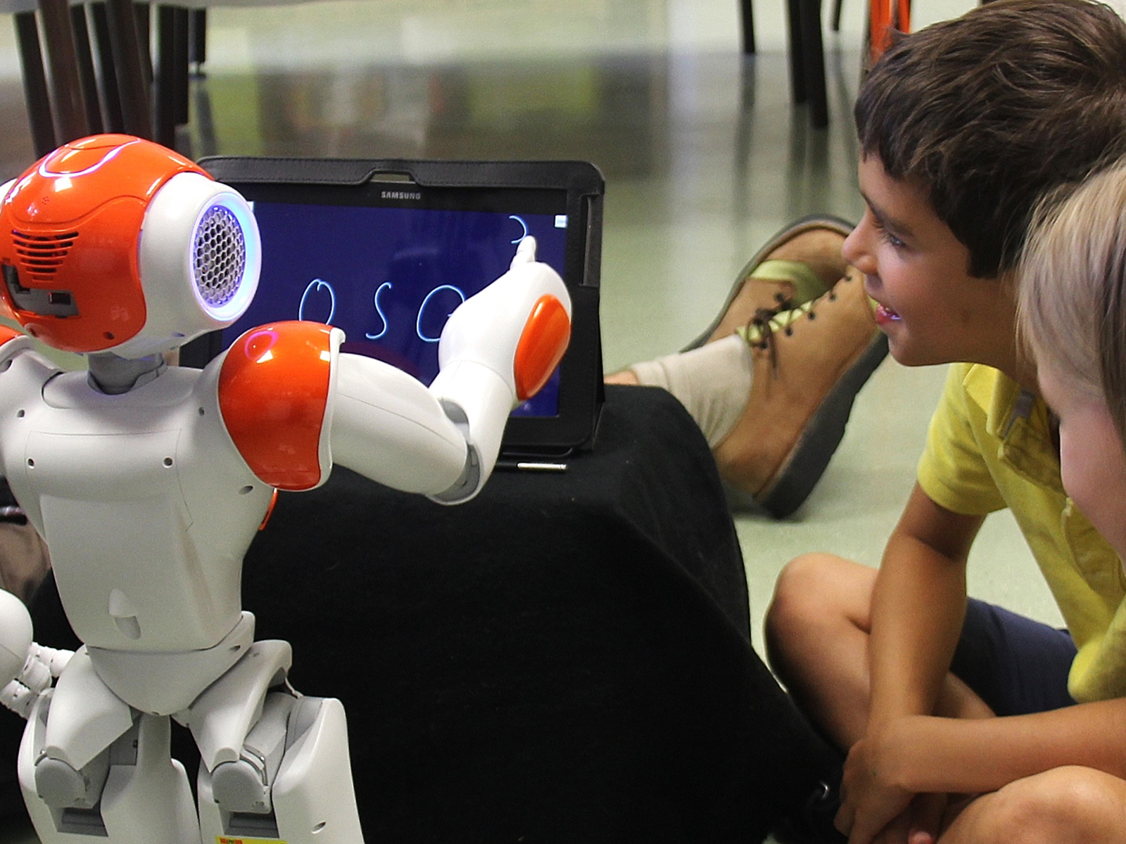
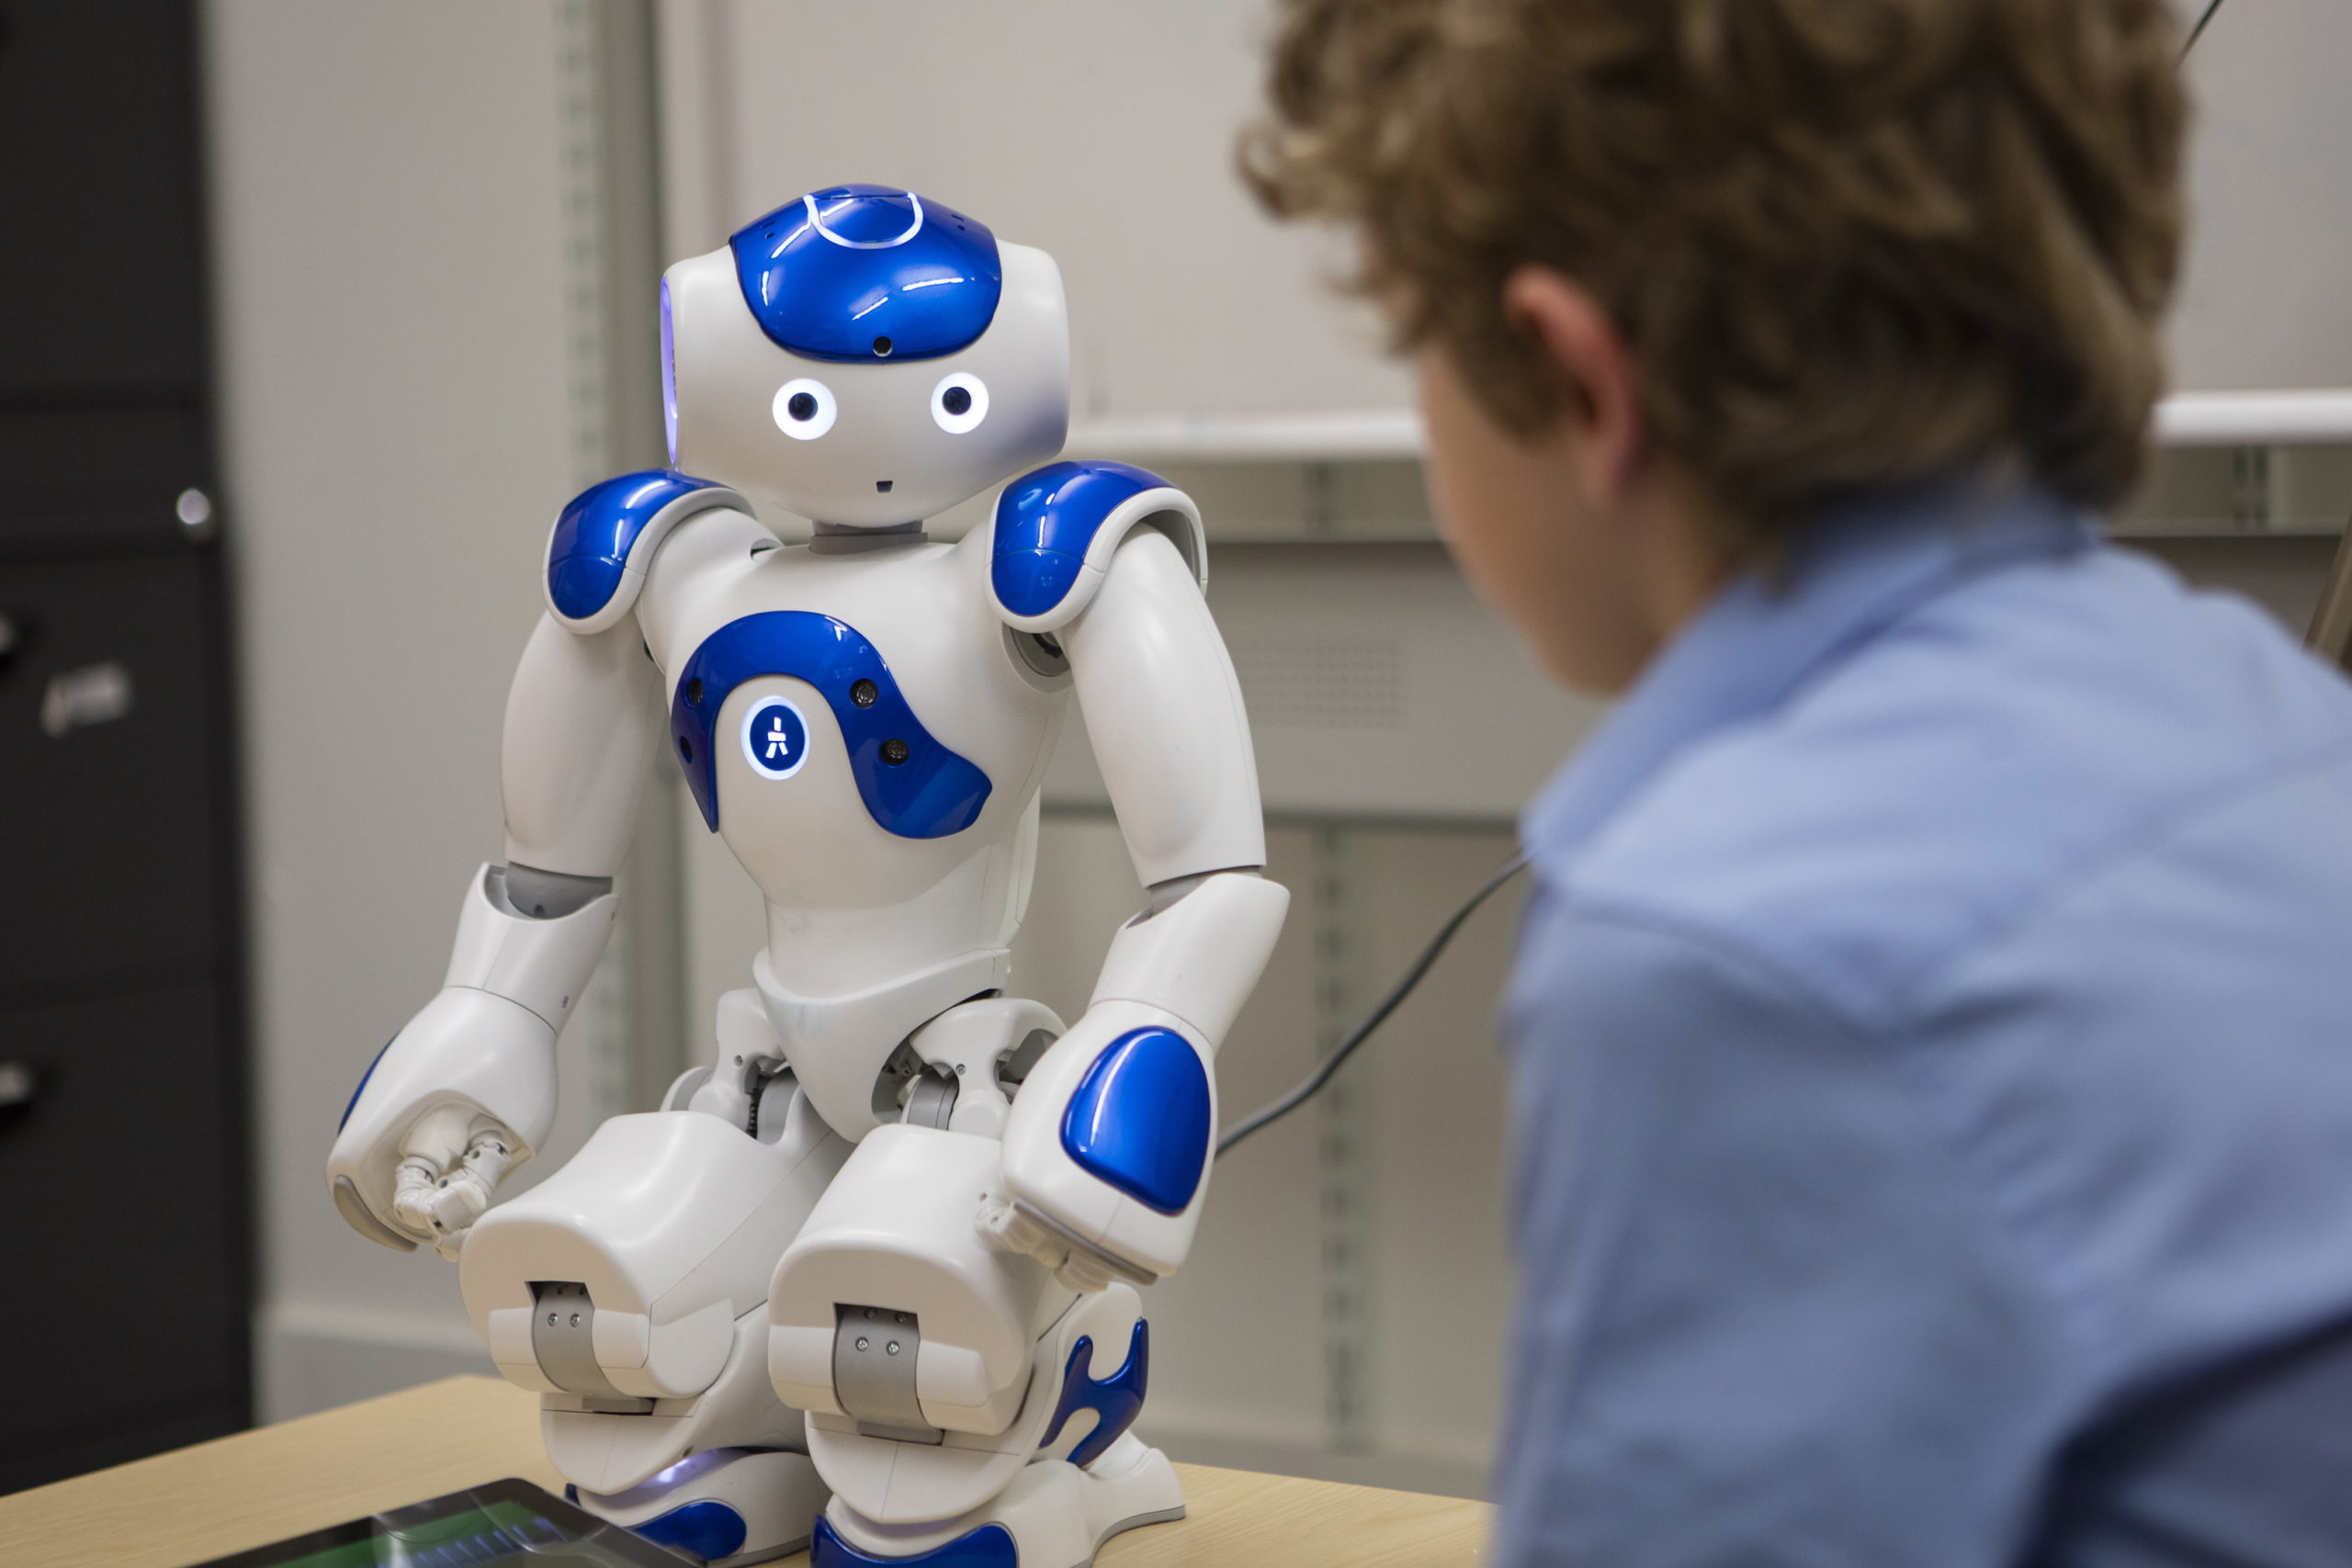
Introduction
Studies have shown that robots can help students develop problem-solving abilities and learn computer programming, mathematics, and science.
The paper is focused on educational humanoid robots for teaching a second language in a primary school.

Slide 4

Instructional tools for teaching elementary language: overview
Common instructional tools can be classified as visual, audio, video, computers, multimedia, Internet and mobile devices.
Multimedia instructional tools are significantly better than mono-media in facilitating learning. In particular, using such category of tools also facilitates students in developing language capabilities.

Slide 5

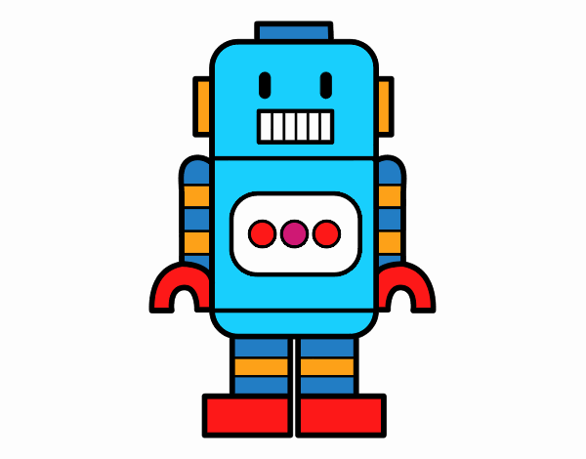
Instructional tools for teaching elementary language: humanoid robots
Humanoid robots can integrate many multimedia tools into one single element and can be programmed to perform tasks, like “hear” or “speak”, to support teaching and to enhance users’ enjoyment and engagement.

Slide 6
Characteristics of robots
Seven common characteristics that might support instruction:
Repeatability
Flexibility
Digitization
Humanoid appearance
Body movement
Anthropomorphism
Interaction

Slide 7
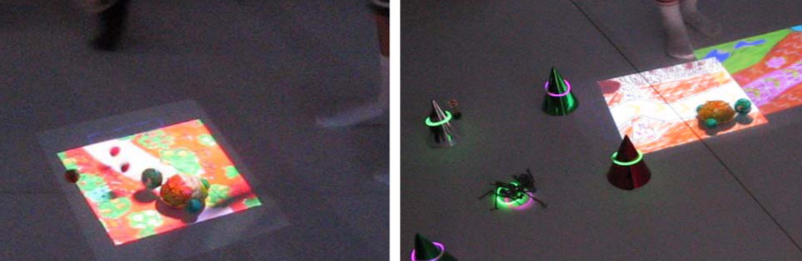
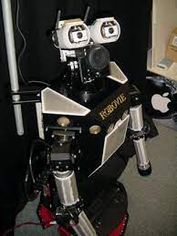
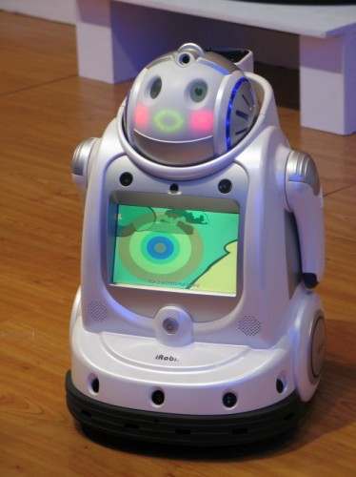
Categories of educational robots
Learning materials
Learners can design and develop their own robots and learn in the process. This results in
increased motivation and
improved skills.
1
GENTORO supports children’s storytelling in a physical space via the child’s use of a handheld projector and a robot.
Learning companions/pets
Humanoid robots can naturally be regarded as learning companions.
2
ROBOVIE behaves as an English peer tutor for Japanese students to encourage children in improving their language abilities.
Teaching assistant
Robots that accompany and encourage students to learn. They can help instructors to present materials.
IROBI displays information via a monitor in its belly and can move the arm to direct students to key points on the monitor.
3

Slide 8
Experimental scenarios: modes
Storytelling mode
The robot can present stories with different voices and combine speaking with actions or sound effects.
Oral reading mode
The robot leads students to recite vocabulary and sentences.
Students exercising their verbal ability will learn to speak more fluently.
Cheerleader mode
The robot encourages students to partecipate in the games.
When a team/child wins, the robot will dange and shout for joy.
Action command mode
Question-answer mode
Children acquire comprehension ability by responding to commands.
The robot asks students to perform a task and viceversa.
Students are encouraged to use the foreigh language to communicate and improve their competence.
The robot can chat with a child and invite him/her to continue talking.
In the meanwhile, the teacher can focus on students’ pronunciation.
In this way, children are encouraged to partecipate in the learning activities.
Telling a story in an effective way to stimulate students to learn a language.

Slide 9
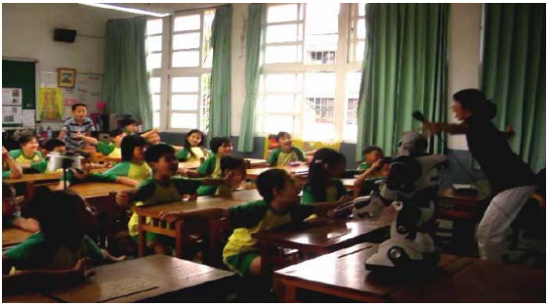
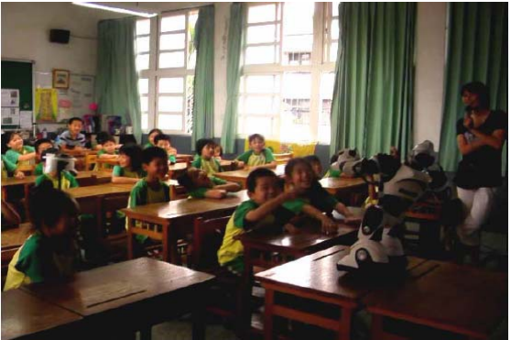
Experimental scenarios: pictures
Teacher telling a story with the robot.
Students giving the robot commands.

Slide 10
Discussion
1) Students demonstrated positive and engaging reactions with more attention and partecipation during the lectures. 2) Robots can be used as interactive interlocutors for teachers and pupils. 3) Teachers and students can design their own teaching materials that subsequently get performed by the robot.
1) Robots can be expensive and complex. 2) Instructors worry that children can destroy or damage the hardware. 3) Challenge to design easy-to-use human-robot interfaces for non-expert teachers.

Slide 11
Conclusions and comments
Educational robots are helpful for students in developing collaboration and problem-solving abilities.
Robots have the potential to be useful in language teaching.
Students responded with high motivation levels. They practiced listening and speaking by interacting with the robot.
Children’s reactions and teachers’ opinions indicated that robots could create an interactive and engaging learning experience.
Our project aims at providing a human-robot interactive framework to teach users a second language.
The adopted robot will be humanoid (e.g., Pepper) to exploit the benefits addressed in the reference paper.
Users can not be necessarily of primary-school level: our work will be referred to every category of students.

Slide 12
References
Chih-Wei Chang, Jih-Hsien Lee, Po-Yao Chao, Chin-Yeh Wang and Gwo-Dong Chen “Exploring the Possibility of Using Humanoid Robots as Instructional Tools for Teaching a Second Language in Primary School", 2010, Article in Educational Technology & Society.

